Slide 3

Alfredo Jiménez
MICROSOFT
Services Consultant
Enterprise Communication Global Practice

Slide 4
Skype for Business: Un paso adelante en Comunicaciones Unificadas

Slide 5
Agenda
Interfaz de usuario Skype for Business
Skype Directory Searh en detalle
Funcionalidades de Telefonía
Call Via Work en detalle
Integración con equipamiento de vídeo conferencia
Video Interoperability Server (VIS) en detalle
Integración híbrida para nuevas funcionalidades on-line
Broadcast Meeetings en detalle

Slide 6
Interfaz de usuario Skype for Business

Slide 7
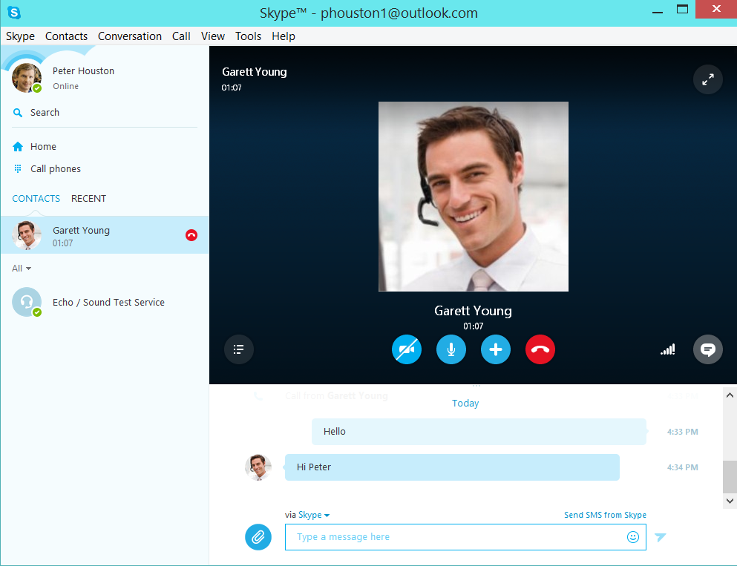

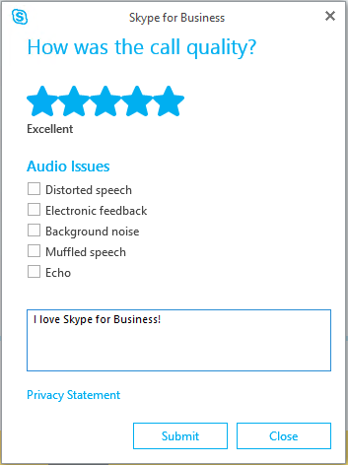

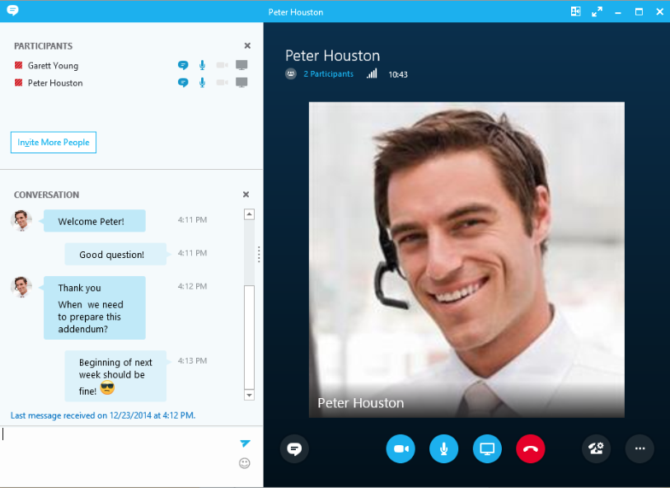
Interfaz de usuario Skype for Business

Slide 8
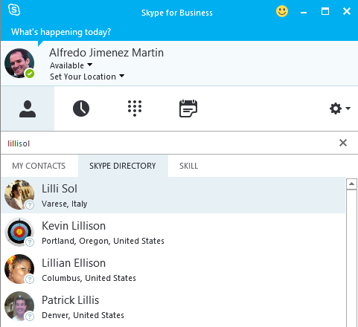
Interfaz de usuario Skype for Business

Slide 9


Online Services
Skype Graph
Service
Lync
Federation Edge
Skype for Business – Skype Connectivity Gateway
Skype Contact Store
Edge
Skype Chat Federation Gateway
Skype Chat Service
Skype Client
Skype for Business Pool
Skype for Business Online
On-Premises
User
On-Line
User

Slide 10
Interfaz de usuario Skype for Business
Users will see Skype user names in most UI, but you’ll see skypename@skypeids.net in logs.
Search by
Display name John Doe
Display name + location – Ex: John Doe in Spain
Email – Ex: johndoe@outlook.com
Phone – Ex: 123-456-7890
Skype ID – Ex: JohnDoe1456
Skype graph service would throttle search requests from any on-premise customer / online tenant if the request rate exceeds 15 requests / second.
Search requests land on Skype for Business Front end which in turn route to Skype graph Service through the Skype for Business Edge server via port 443.

Slide 11
Supported Deployment matrix for Skype Directory Search
 | Skype for Business Server 2015 Front End | Lync Server 2013 (or older) Front End | Comments
Skype for Business Server 2015 Edge | Supported | Not Supported | Skype for Business Server 2015 and Edge are prerequisites for Skype Directory Search
Skype for Business Server 2015 Edge + Lync Server 2013 Edge deployed side-by-side | Supported | Not Supported | Skype Directory Search traffic flows through Skype for Business Server Edge servers. Federation traffic goes through edge configured by the administrator. For example, the administrator could choose to continue to send federation traffic through Lync Server 2013 Edge servers which would not support Skype Directory Search.
Lync Server 2013 (or older) Edge | Not Supported | Not Supported

Slide 12
Deployment & Configuration
Uses Skype for Business/Lync Server’s federation access architecture
Microsoft PIC set up needed (http://pic.lync.com)
Provisioning Guide for Skype for Business-Skype Connectivity
Skype Search and SkypeID routing requires Enterprises already enabled for Skype federation to upgrade to Skype for Business.
Netwokrking flow: Client to the Pool (TCP 443 – same as ABWQ) The Pool to the Edge (TCP 4443 – same as CMS replication) Edge to Skype Directory Search in Azure (TCP 443 - Access Edge Interface)

Slide 13
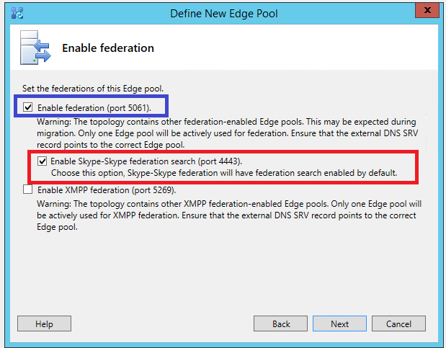
Topology Configuration

Slide 14
Demo: Skype Directory Search

Slide 15
Funcionalidades de Telefonía

Slide 16
Funcionalidades de Telefonía
Incoming and Outgoing Calls
Dial Plan and Normalization Rules
Voice Routes
Voice Policies
Dial In Conferencing
PSTN User dials the conference access number followed by the conference Id
Available for Enterprise Voice and non-Enterprise Voice users
Conference dial-out for non-EV users
New conference policy setting allows authenticated-but-non-enterprise-voice users to dial out using the organizer’s policy.
Anonymous participants have always used the organizer’s policy.
Location-based routing
Routes the call based on location of the caller
Scoped to specific locations, gateways and users
Uses existing Lync networks sites/subnets
Remote Call Control not supported anymore → Replaced with Call Via Work

Slide 17
Call via Work
Enterprise Voice for PBX Users
Skype for Business users can make voice calls using any PSTN phone, including existing PBX endpoints
Leverages existing Direct SIP connectivity between PBX systems and Lync/Skype for Business
User experience
Skype for Business dials out to PSTN or desk phone number to connect user, then connects with far-end destination
Features
Presence update and call control from Skype for Business client
Mid-call control capabilities preserved on PBX phone
Inbound
Simultaneous Ringing is tied with activation of CvW feature
Call via Work doesn’t have an inbound experience
Infrastructure
Should operate with any supported PSTN egress
May find complexity with numbering support
Cloud
Not available in Lync Online

Slide 18
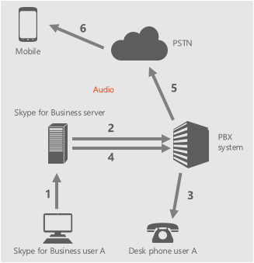
Outbound call to external user (PSTN)
User A initiates a call to PSTN
UCWA places the initial call to self/desk phone
PBX rings the desk phone of user A
Once answered, UCWA places second call to PSTN
Ring back is provided to user A’s desk phone
Once PSTN answers, call is connected
User experience | Conversation window
Call initiated from Skype for Business client | Available
Call initiated from desk phone | Not Available

Slide 19
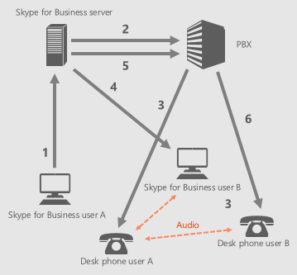
Outbound call to internal user
User A initiates a call to user B
UCWA places the initial call to self/desk phone
PBX rings the desk phone of user A
Once answered, UCWA places second call to user B
Since user B is enabled for CvW and set Simulring to their own desk phone, ms-skipRnl header is used to force another call out to user B’s desk phone
Once user B answered on Skype for Business client or desk phone, call is connected
User experience | Conversation window
Call initiated from Skype for Business client | Available
Call initiated from desk phone | Not Available

Slide 20
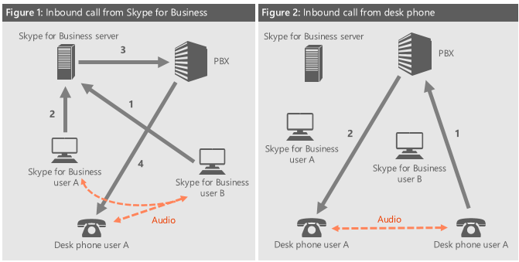
Inbound call from internal user
User B calls user A from Skype for Business client or PBX phone
PBX or Skype for Business Server receives the call (depending on who originated the call—see below)
If Skype for Business Server receives the call, user A’s endpoint is alerted. Since user A is enabled for CvW and set to simulring their own desk phone, the ms-skipRnl header is used to force another call out to user A’s desk phone
If PBX receives the call, PBX rings the desk phone of user A as shown below

Slide 21
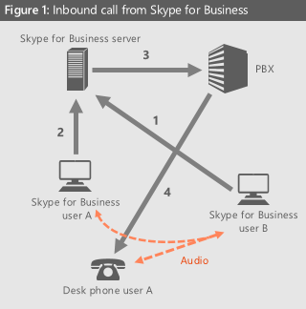
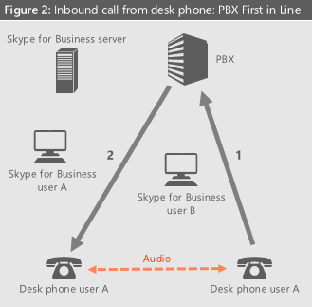
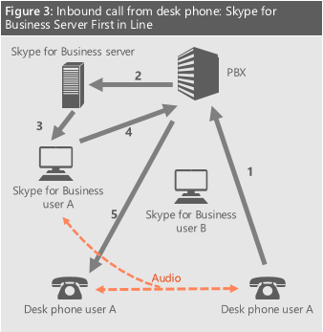
Inbound call from external user (PSTN)
PSTN user calls User A
PBX or Skype for Business Server receives the call (depending on who originated the call—see below)
If Skype for Business Server receives the call, user A’s endpoint is alerted
Since user A is enabled for CvW and set to simulring their own desk phone, the ms-skipRnl header is used to force a call out to user A’s desk phone

Slide 22
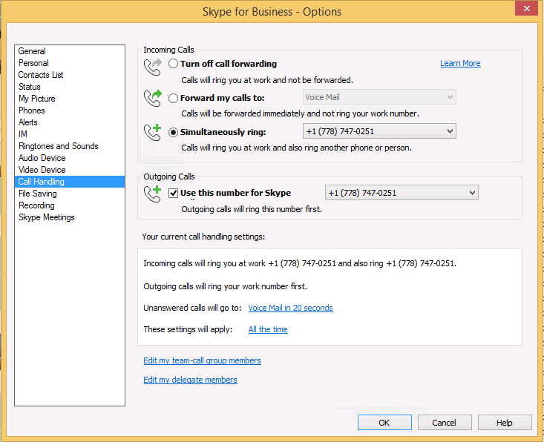
User configuration

Slide 23
Funcionalidades de Video

Slide 24
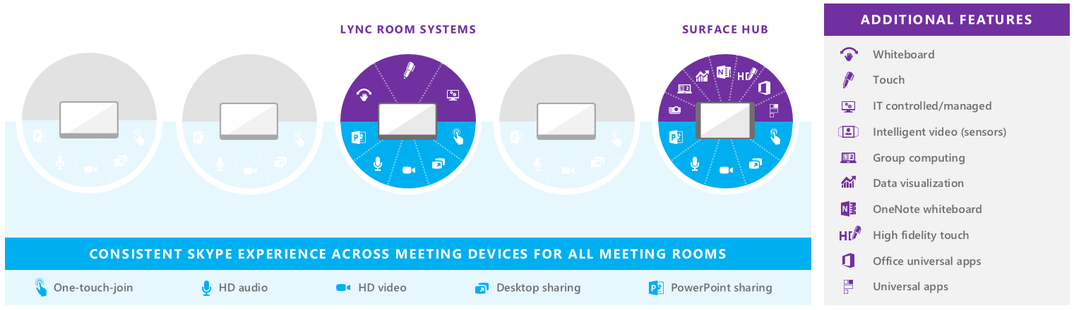
Estrategia de dispositivos de vídeo
Enable a consistent, rich Skype collaboration experience across meeting devices
Power the partner ecosystem to serve the full spectrum of 50 million meeting rooms
Offer Surface Hub to illustrate the art of the possible and to accelerate adoption

Slide 25
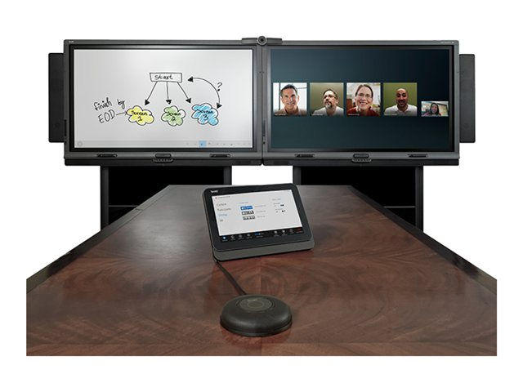
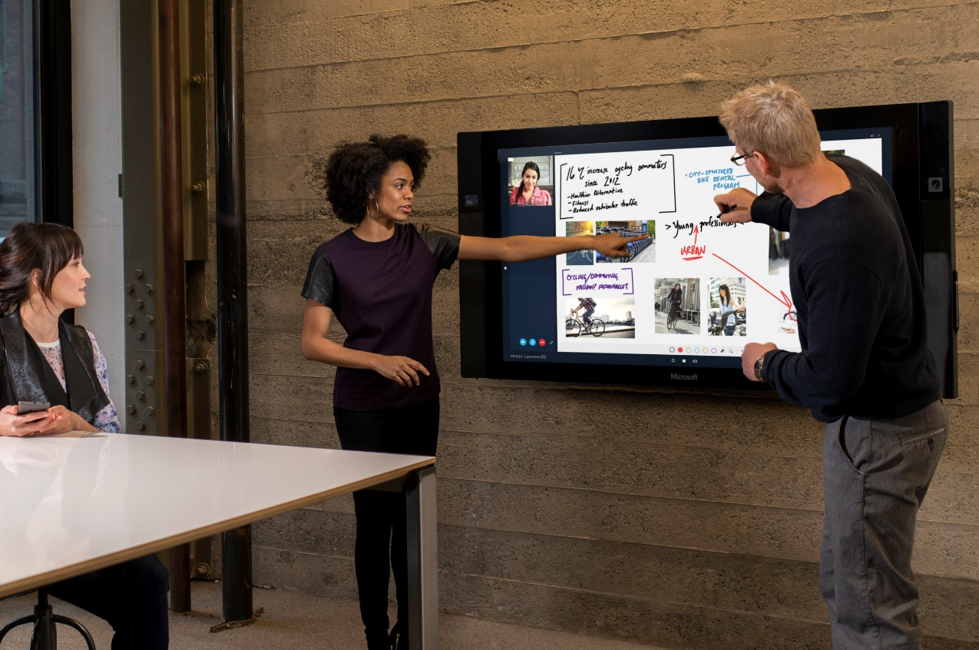
Lync Room System Vs Surface Hub

Slide 26
Video Interoperability Server (VIS)
New server role both on premises or hybrid with on premises
Aimed at legacy Video Interoperability
VIS is a software solution “built in” to Skype for Business and is scalable
Allowing existing VTCs to connect to Skype for Business, leveraging existing investments
Connectivity to conferences with audio and video as well as peer-to-peer
Simplifies interoperability and eliminates the need for third-party infrastructure
The Skype for Business meeting experience is consistent and familiar to users

Slide 27
VIS to CUCM SIP Trunk Mode
Signaling
Conference
Auto
Attendant
Media
A/V
MCU
Cisco
Unified
Call
Manager
VIS
Capabilities:
Signaling: Cisco/Tandberg VTCs support SIP, H.323
Support SDP for media negotiation
Media: Cisco/Tandberg VTCs support RTP/RTCP and the H.264 AVC codec which was standardized in RFC 6184

Slide 28
Escenario soportado
VTCs remain registered to Cisco infrastructure
Video SIP trunk between CUCM and VIS
VTCs are Cisco endpoints and can call Skype for Business
Outbound calls from Skype for Business to CUCM not supported in this initial release
Conferencing functionality:
VTC can dial into conference via CAA
Drag-and-drop not supported
Calls from VIS to VTC are not supported

Slide 29
Integración Híbrida

Slide 30
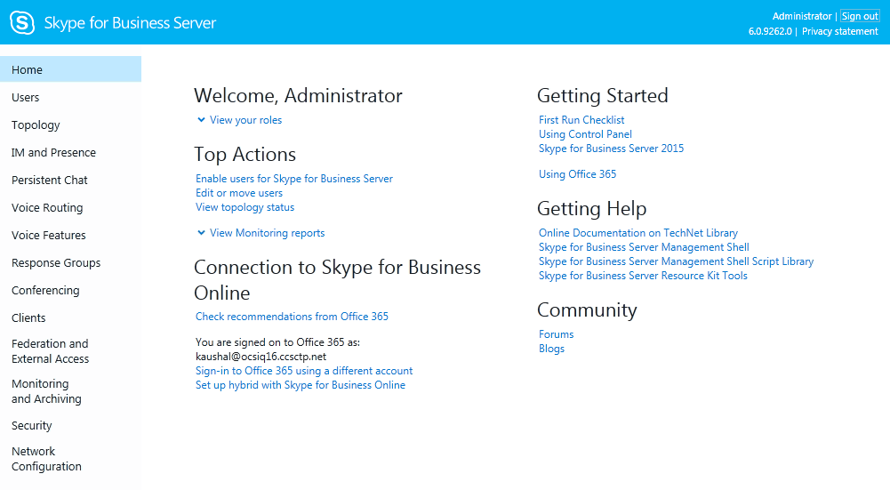
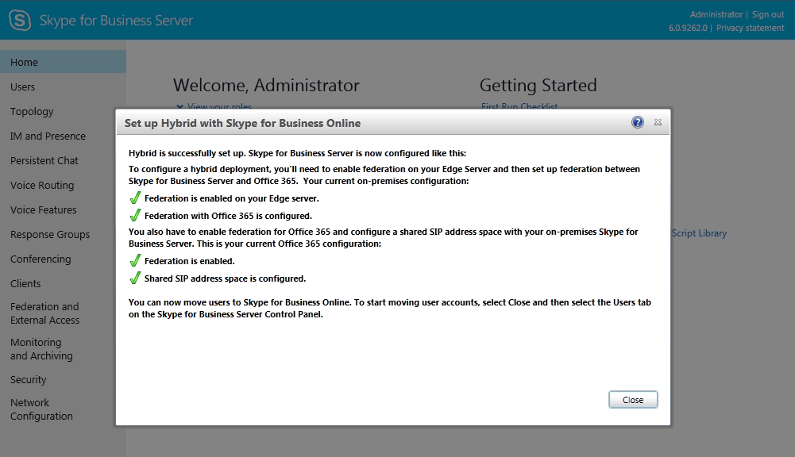
Hybrid Manageability Improvements

Slide 31
Funcionalidades OnPrem vs Online
Lync Server 2013
Las funcionalidades Online son limitadas
Todas las funcionalidades Online existen OnPrem
Despliegue OnPrem para disponer de las funcionalidades no disponibles Online:
Enterprise Voice, Monitoring, Persistent Chat,…
Skype for Business Server 2015
Las funcionalidades Online son limitadas
No todas las funcionalidades Online existen OnPrem
Despliegue OnPrem para disponer de las funcionalidades no disponibles Online
VIS, Persistent Chat,…
Despliegue OnLine para disponer de las funcionalidades no disponibles OnPrem
Enterprise Voice, Monitoring, Persistent Chat,…

Slide 32
Features – Online, OnPremise, Hybrid
 | On premises user | On premises user + hybrid features | Online user + hybrid features | Online user
IM/Presence | Yes
Conferencing | Yes
Dial-in conferencing | Via local PBX/PSTN or New PSTN Conferencing in Office 365** |  | Audio Conferencing Provider or New PSTN Conferencing in Office 365*
Enterprise Voice | Via local PBX/PSTN |  | New PSTN Calling in Office 365*
 | Via local PBX/PSTN***
Persistent Chat | Yes |  | No
Broadcast meeting* | No | Yes
Cloud conferencing recording* | No | Yes
Video Interop Server | VIS calls possible |  |  | No
APIs | All APIs |  |  | Selected APIs
* Available post RTM
** planned feature
*** available for server today; planned feature for online user in hybrid configuration

Slide 33
Going BIG with Meetings
 | Skype for Business | Large Meeting | Broadcast
Maximum audience size | 250 | 1000 | 10,000
Presenter Camera A/V | ✓ | ✓ | ✓
PowerPoint | ✓ | ✓ | ✓
Desktop & App Sharing | ✓ |  | ✓
Attendee Camera A/V | ✓
Apps (Whiteboard, Poll, Q&A) | ✓ | ✓
PSTN Access | ✓ | ✓ | ✓
Cloud based meeting recording |  |  | ✓
Client DVR controls (ex: pause, rewind) |  |  | ✓
Personalized meeting experience |  |  | ✓
Meeting Producer role |  |  | ✓

Slide 34

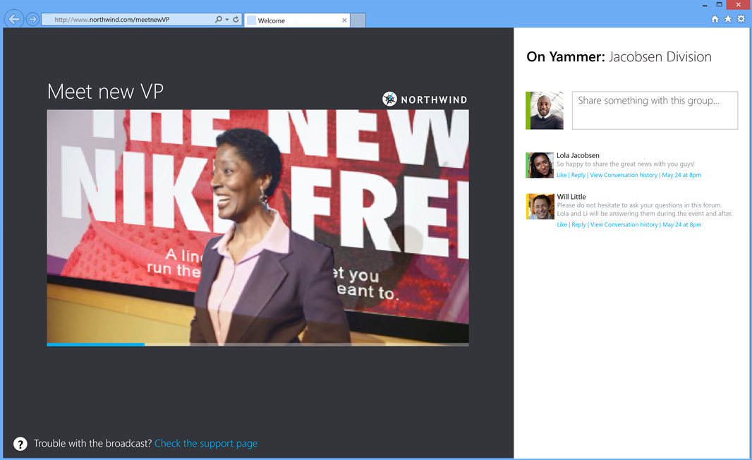
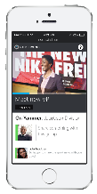

Basic Building Blocks
Producer
Skype for Business
Online ‘Inner Meeting’
Azure Media Services
HD Video
Local / Remote Speaker
Studio or Auditorium A/V
Content Delivery Network
Federated presenter accounts
Web Attendee Client
Mobile Clients

Slide 35
Scheduling a Broadcast
Organizers can…
Discover broadcast options when scheduling a large meeting in Outlook
Create and manage broadcast events in the Skype for Business broadcast portal
Pre-meeting
Manage access settings, attendees list and event team roster
Customize the event including theme, curtains and branding imagery
Post-meeting
Download or publish meeting recordings
Access meeting attendee reports, count, device mix, other telemetry

Slide 36
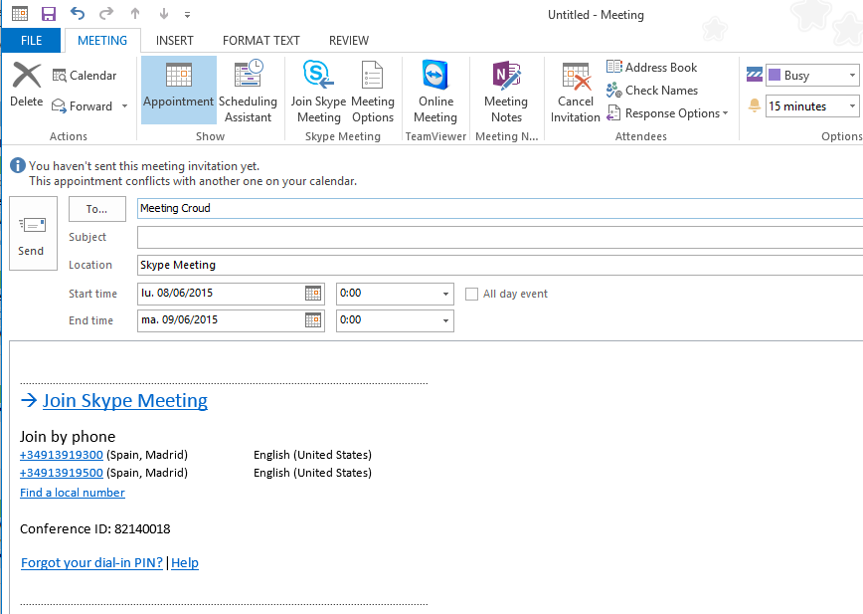
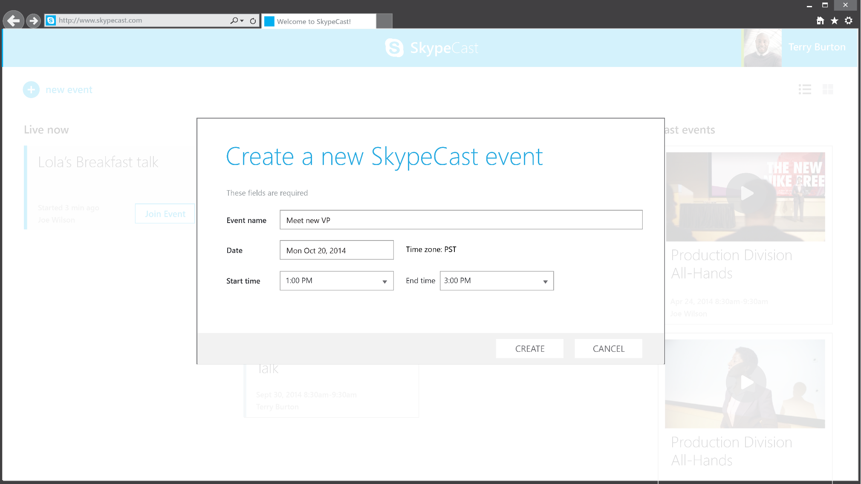
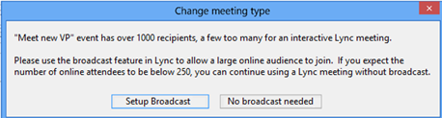

Slide 37
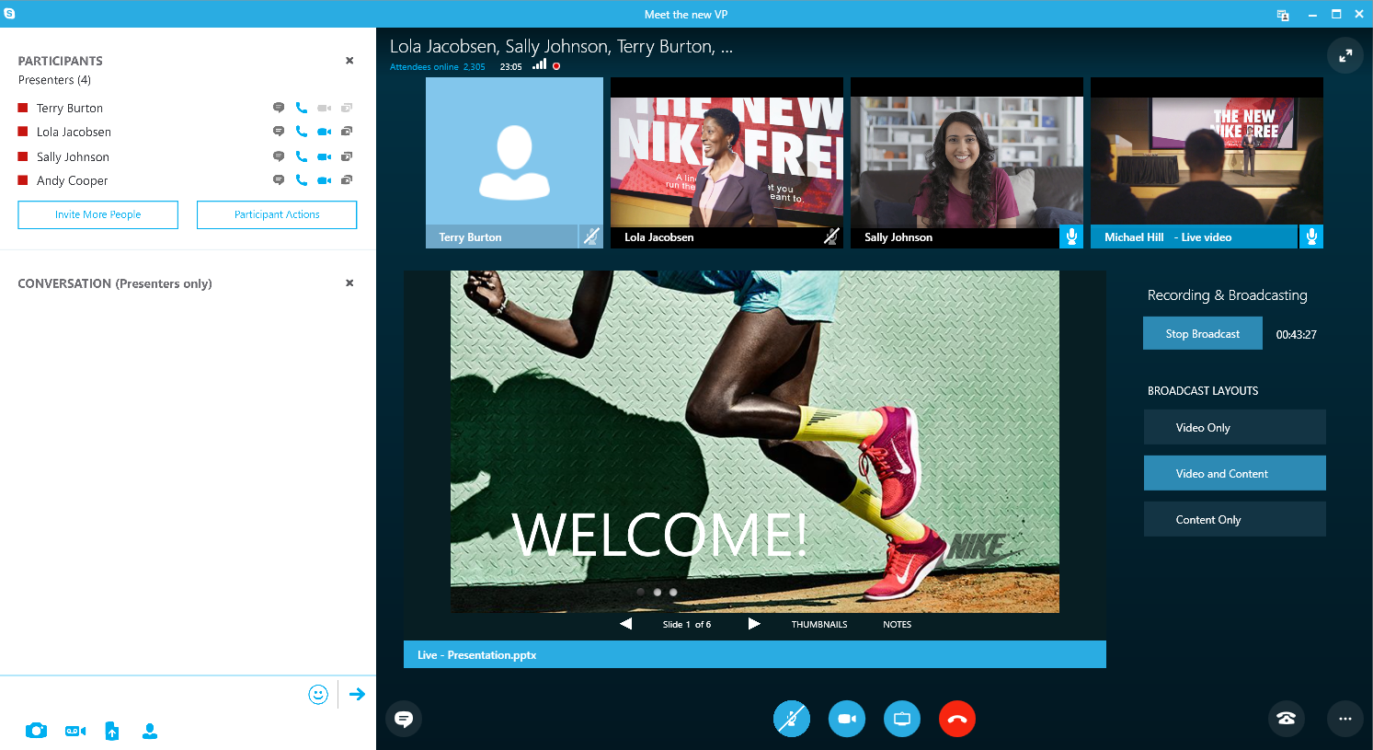
Produce using Skype for Business

Slide 38
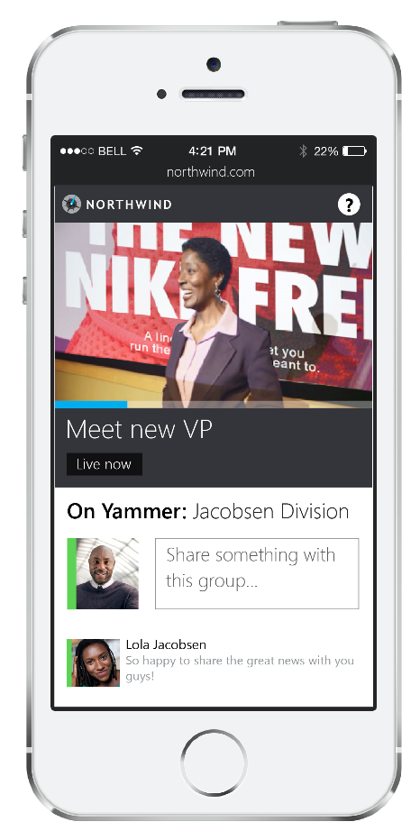
Attendee Experience

